Slide 1
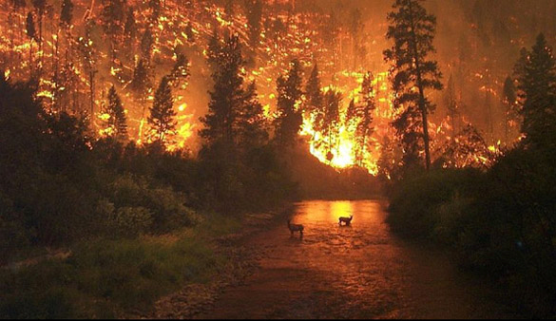
Santa Clara County
FireSafe Council
Emergency Evacuation Preparedness Workshop
Pre
Presented by Gretchen Hayes
www.icmpa.umd.edu/salzburg/climatechange/index.php/category/bringingupthekids/continent/north/
http://www.sccfiresafe.org
Notes:
Fire in Bitterroot National Forest - Montana

Slide 2
Today’s Goals
Understand defensible space principles
Review Action Plan and Emergency Kit Checklist
Begin to assemble your “Go Bag”
Assess community evacuation map
Create your own family emergency plan

Slide 3
Defensible Space
“Ready ”

Slide 4
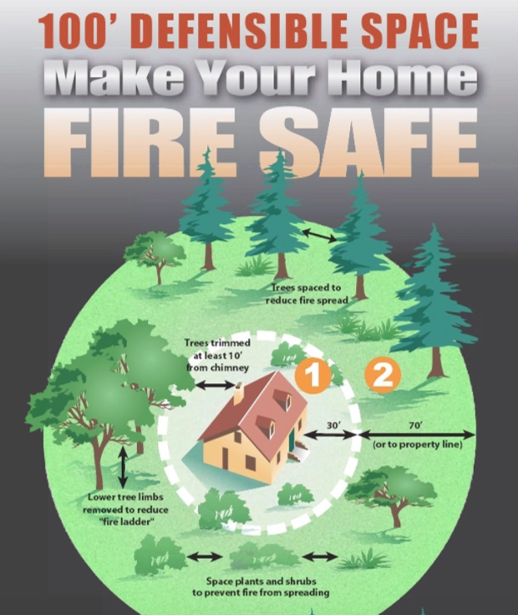
Notes:
5’ non combustable

Slide 5
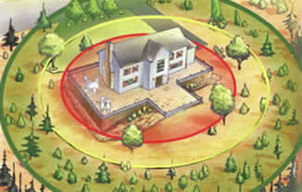
Defensible Space
Creates a safer area for firefighters to protect a home
Reduces fuels and opportunity for fire to reach structure
Protects homes
Helps keep forests healthy
www.calmast.org/sbc/html/defensible_space.asp
Notes:
Defensible Space is an area around a home that has reduced fuel, so that fires will slow down when they approach this area. It also makes it safe for fire fighters to try to save the home. Fire fighters choose which homes they can save. If you have Defensible Space, you fire fighters will probably stop and try to save your house.

Slide 6
Ember resistance
5' non-combustible ember resistant zone around the house
1/8" mesh Vent Screens
Non-combustible window shades and curtains
www.calmast.org/sbc/html/defensible_space.asp
Notes:
Defensible Space is an area around a home that has reduced fuel, so that fires will slow down when they approach this area. It also makes it safe for fire fighters to try to save the home. Fire fighters choose which homes they can save. If you have Defensible Space, you fire fighters will probably stop and try to save your house.

Slide 7
Many communities in Santa Clara County have high fire risk

Slide 8
Wildfire Action Plan
“ Ready, Set ”

Slide 9
Be Prepared
Have fire extinguishers - maintain
Know how to shut off gas - label that valve, keep wrench at valve if needed
Maintain emergency contact list
Have a portable radio and extra batteries
Notes:
know where power and water shut off is - don’t shut water off

Slide 10
Be Prepared
Create your evacuation plan and grab list
Assemble an emergency kit for each person and keep one in the car
Have a plan if you are not home
Notes:
know where power and water shut off is - don’t shut water off

Slide 11
Create your Evacuation Plan
Designate 2 meeting locations
One right outside home
One outside your neighborhood
Know your escape routes
From your home
From your neighborhood

Slide 12
Create your Evacuation Plan
Have an evacuation plan for pets and livestock - work with neighbors if you are not home
Have a family communication plan

Slide 13
Family Communication Plan
Designate someone out of state as a point of contact
Make sure children know their full name and their parents full names and have a plan for children’s evacuation
Notes:
what if your kids are home and you are not? with a sitter or by themselves

Slide 14
Family Communication Plan
Write down contact names and phone numbers and keep these up to date
Write down your meeting locations
Meet with your family and go over the plan - practice
Notes:
what if your kids are home and you are not? with a sitter or by themselves

Slide 15
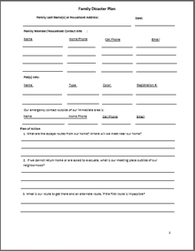
Fill out your family plan worksheet
Notes:
10 minutes – talk about various meeting places fill our worksheet.

Slide 16
Evacuation Routes

Slide 17
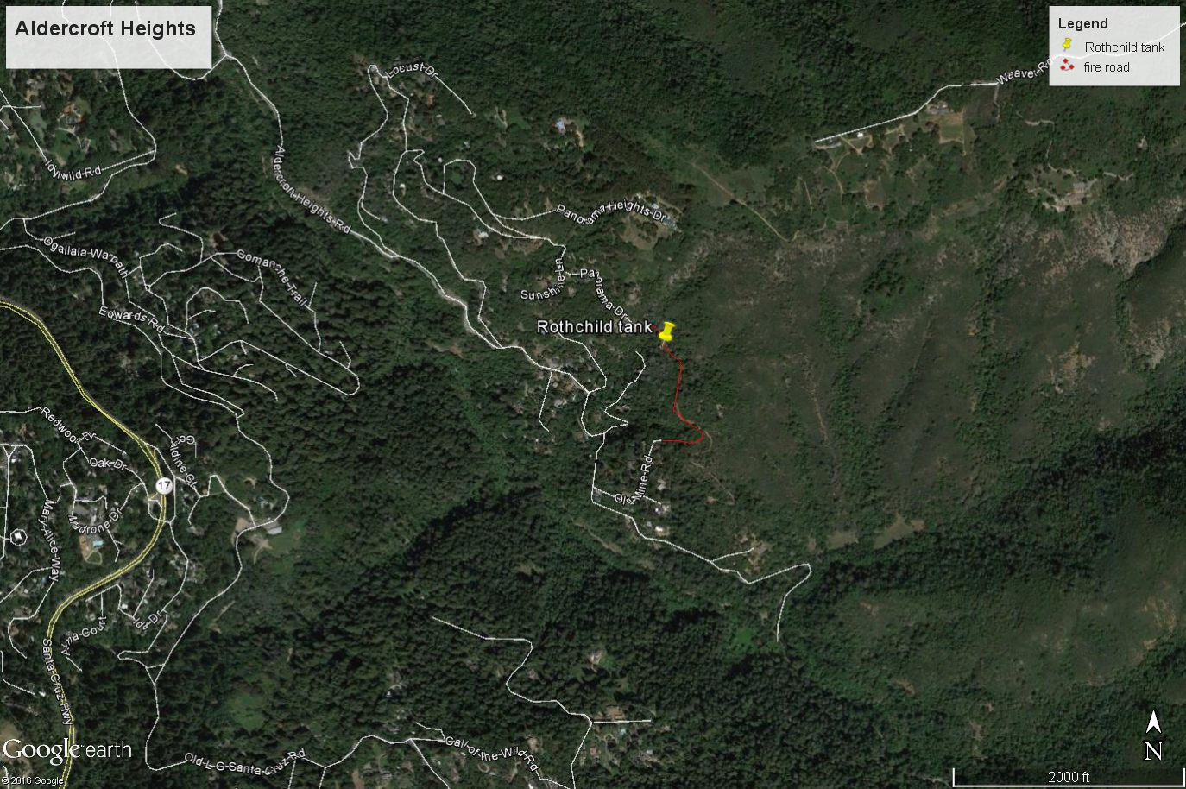
Neighborhood Evacuation Routes
Know your roads - Explore your neighborhood
Know all possible evacuation routes from your home
Know which streets are dead ends
Notes:
Add specific map

Slide 18
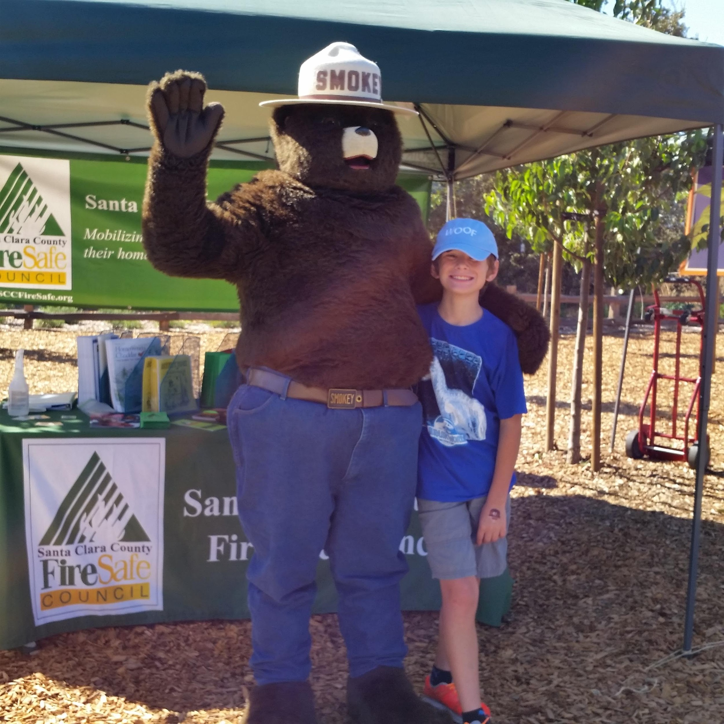
Get to know your Neighbors!
Have a “block “ party
Share phone numbers
Walk your dog
Go for a walk
SAY HI ☺
Bring a gift
Have a plan to help each other in case you are not home
Notes:
go meet your neighbors bring them food

Slide 19
Assemble your Go Bag
3 day supply of food and water
Evacuation map, grab list, contact list
Prescriptions/eyeglasses
Extra keys/ credit cards/cash/copies of important documents
Notes:
Use my go bag for example –

Slide 20
Assemble your Go Bag
Change of clothes
Flashlight/radio/ extra batteries
Sanitation supplies
Pet supplies
Notes:
Use my go bag for example –

Slide 21
Assemble your Grab List
List should only have items that will fit in the car, with the people and pets in the car
Make two copies, one that you look at regularly (inside the kitchen cabinet?) and one that is in your go bag.
Notes:
Use my go bag for example –

Slide 22
First Aid Kit
Variety of bandages
Antibiotic ointment
Antiseptic wipes
Tweezers
Cold compress
Gloves
Gauze pads and roller bandages
Thermometer
Aspirin or Tylenol
antihistamine
Small trash bag
scissors
Pencil & paper
ace wrap
any family info on allergies, diabetes etc

Slide 23
Wildfire is Coming
“Ready, Set, Go ”

Slide 24
Pre-Evacuation steps – if time allows – Grab List
Load pets in carriers first
Easily carried valuables
Photos
PC or hard drive
Chargers
Insurance documents
Keep a list of last minute things to grab somewhere handy
Notes:
Hand out cards to write down our personal lists – take 10 minutes to go over and prep

Slide 25
Pre-Evacuation steps – if time allows – Outside
Check the 5' zone. Put flammable items, patio furniture etc, inside or outside away from the house more than 30’
Turn off propane tanks
Move BBQ away from structures

Slide 26
Pre-Evacuation steps – if time allows – Outside
Open wooden gates - disconnect fence from house
Livestock closed in coop, stable
Check on your neighbors

Slide 27
Pre-Evacuation steps – if time allows – Outside
Connect garden hoses/stream nozzle - leave sprinklers off
Fill buckets, place outside near doors
Run water in gutters if they have leaves
Dampen 5' combustibles (deck edge)

Slide 28
Pre-Evacuation steps – if time allows – Outside
Place a ladder by the corner of your home
Check on your neighbors

Slide 29
Pre-Evacuation steps – if time allows – Indoors
Shut all doors, windows and screens
Shut off gas and AC
Leave your lights on interior and outside
Review grab list, video home tour

Slide 30
When it is time to leave
Review your evacuation plan checklist
Make sure your emergency kit is in your vehicle
Cover up to protect yourself from embers
Don’t wait for an evacuation order – if you feel threatened, LEAVE

Slide 31
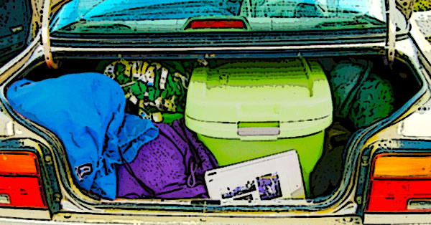
How to pack your car
Think about the items that you are taking and how they will fit into your vehicle.
Make room for people and pets first.

Slide 32
LEAVE
Evacuation by authorities is not optional, help the firefighters and police do their job and leave promptly to safety.
Go to your meeting location
Let your family or out of state contact know where you are

Slide 33
Don't stay - the grim truth
Stories of people who stay and fight fire are only told by people who survive.
Australia's "Stay and Defend" policy resulted in 210 people dying in 2009 - those people never got to tell their stories

Slide 34
Don't stay - the grim truth
CAL FIRE developed READY-SET-GO after Australia's disasters
Stay = funeral pyre, Late in leaving = die on the road in your car or running into flames

Slide 35
Questions?
Get started tonight- introduce yourself to the neighbor sitting next to you!

Slide 36
What to do after this workshop
1 - Finish updating phone numbers
2 - Put your evacuation map in your glove box, post your grab list in the cupboard
3 - Finish assembling your “Go bag”
4 - Practice with your family!

Slide 37
Thank you from your Santa Clara County FireSafe Council
More Resources
https://www.sccgov.org/sites/oes/Pages/Office-of-Emergency-Services.aspx
http://www.fire.ca.gov/current_incidents

